Slide 1




HOW TO ENJOY GOD’S PRESENCE THROUGH HIS WORD

Slide 2

Gen Z Translation : Genesis 1:1-4
1. In the very start, God made the sky and the earth.
2. So basically, at first, the earth was a hot mess. It didn't have any structure or anything, just emptiness and darkness all around. But then, the Spirit of God started doing its thing, cruising over the oceans.
3. Then God was like, 'Yo, let there be light,' and boom, there was light.
4. And God was like, 'Yo, this light is lit!' So, God separated the light from the darkness. Like, He made sure they don't mix, you know?

Slide 3

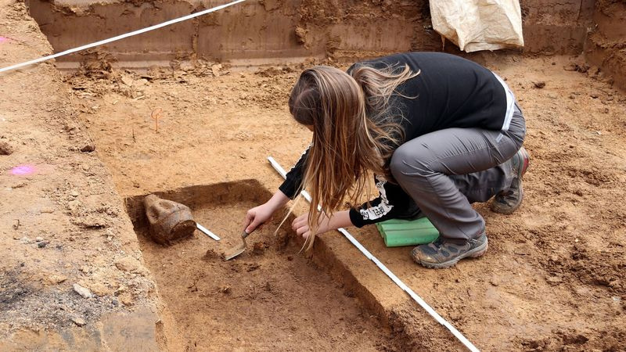
IN 2018, A ROMAN-ERA CEMETERY WAS UNCOVERED NEAR FRANKFURT, GERMANY, IN WHAT WAS ONCE THE ANCIENT ROMAN CITY OF NIDA

Slide 4
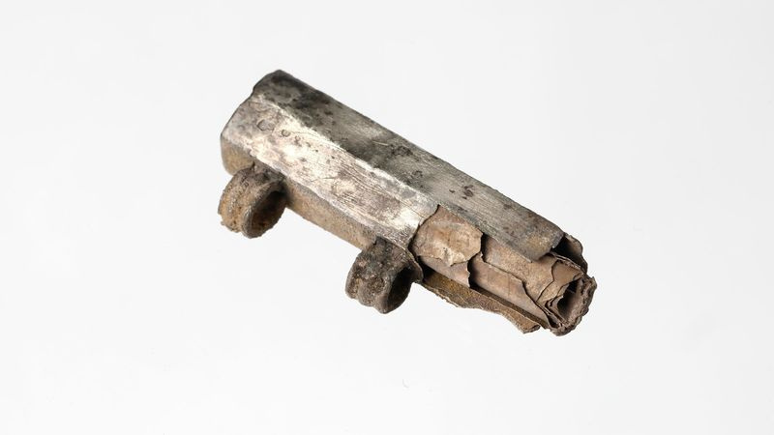

Slide 5
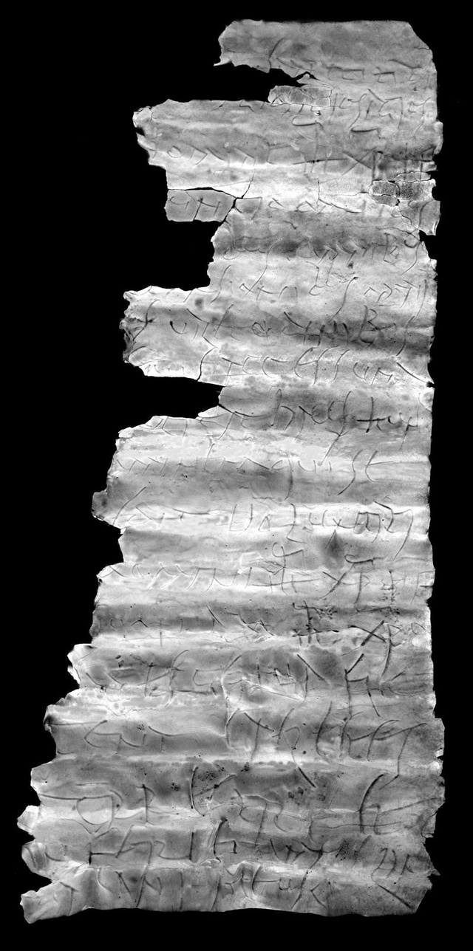
When translated into English, the text reads:
"(In the name?) of St Titus.
Holy, holy, holy!
In the name of Jesus Christ, Son of God!
The Lord of the World
Resists (to the best of his ability?) All attacks(?)/setbacks(?). The God(?) grants the well-being
Entry:
This means of salvation(?) protects The human being who Surrenders to the will Of the Lord Jesus Christ, the Son of God, Since before Jesus Christ
All knees bow to Jesus Christ: the heavenly The earthly and The subterranean and every tongue Confess (to Jesus Christ)."

Slide 6

STRUGGLES READING
the
BIBLE

Slide 7

State of the Bible report of 2022, data revealed that 26 million people gave up reading the Bible in the past year.

Slide 8

TWO KEY QUESTIONS: WHY AND HOW.
Why the Word Matters in Our Daily Lives?
How can we enjoy His Word?

Slide 9


Why the Word Matters in Our Daily Lives?
1.Staying connected Through His Word

Slide 10

John 1:1-5 (NLT)
In the beginning the Word already existed.
The Word was with God,
and the Word was God.
2 He existed in the beginning with God.
3 God created everything through him,
and nothing was created except through him.
4 The Word gave life to everything that was created,[a]
and his life brought light to everyone.
5 The light shines in the darkness,
and the darkness can never extinguish it.[b]

Slide 11
God’s Creation. Genesis 1:11,20,26 (NLT)
God create Plants
11 Then God said, “Let the land produce vegetation: seed-bearing plants and trees on the land that bear fruit with seed in it, according to their various kinds.” And it was so.
God create fish
20 Then God said, “Let the waters swarm with fish and other life. Let the skies be filled with birds of every kind.”
God create Human
26 Then God said, “Let us make human beings[a] in our image, to be like us. They will reign over the fish in the sea, the birds in the sky, the livestock, all the wild animals on the earth,[b] and the small animals that scurry along the ground.”

Slide 12

Why the Word Matters in Our Daily Lives?
2.Prophecy Through the Word: Knowing Who You Are in God's Plan

Slide 13
But before they were born, before they had done anything good or bad, she received a message from God. (This message shows that God chooses people according to his own purposes;)
ROMAN 9:11 (NLT)

Slide 14
LUKE 1:11-17 (NLT)
11 While Zechariah was in the sanctuary, an angel of the Lord appeared to him, standing to the right of the incense altar.12 Zechariah was shaken and overwhelmed with fear when he saw him. 13 But the angel said, “Don’t be afraid, Zechariah! God has heard your prayer. Your wife, Elizabeth, will give you a son, and you are to name him John. 14 You will have great joy and gladness, and many will rejoice at his birth, 15 for he will be great in the eyes of the Lord. He must never touch wine or other alcoholic drinks. He will be filled with the Holy Spirit, even before his birth.[a] 16 And he will turn many Israelites to the Lord their God. 17 He will be a man with the spirit and power of Elijah. He will prepare the people for the coming of the Lord. He will turn the hearts of the fathers to their children,[b] and he will cause those who are rebellious to accept the wisdom of the godly.”

Slide 15
GOD KNOWS US
Foreknow us
FOREKNEW US
He
He have a plan and purpose for all of us

Slide 16
Word of God is
PROPHECY
for you and an
INHERITANCE

Slide 17
How can we enjoy His Word?
TO ENJOY GOD’S PRESENCE, MEDITATE ON HIS WORD.

Slide 18
THERE ARE BLESSINGS IN MEDITATING
Psalm 1:1-3 (NLT)
"Blessed is the man who walks not in the counsel of the ungodly, nor stands in the path of sinners, nor sits in the seat of the scornful;
But his delight is in the law of the Lord, and in His law he meditates day and night.

Slide 19

How do we meditate on the Word of God?
Meditation in practice
SITTING WITH THE LORD
HEARING THE VOICE OF THE LORD

Slide 20


Seeing
SCRIPTURE
Through the Lens of
JESUS’ LOVE

Slide 21
Mark 12:29-31 (NLT)
"Jesus replied, “The most important commandment is this: ‘Listen, O Israel! The Lord our God is the one and only Lord.30 And you must love the Lord your God with all your heart, all your soul, all your mind, and all your strength.’[g] 31 The second is equally important: ‘Love your neighbour as yourself.’[h] No other commandment is greater than these. ”

