Slide 1
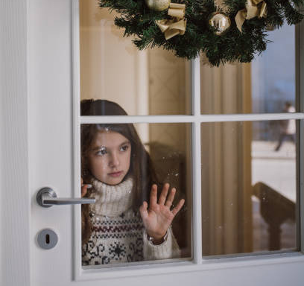
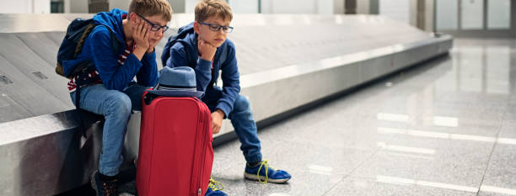
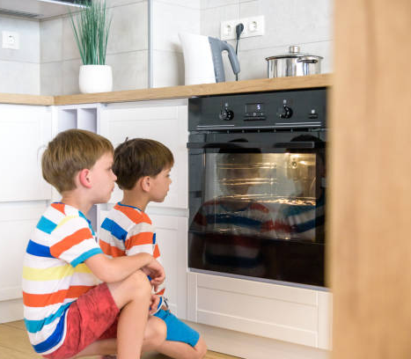
https://www.istockphoto.com/

Slide 2
GOD MOVES IN HISTORY – IT IS HIS STORY
GOD ANSWERS
OUR EXPECTATIONS
IN UNEXPECTED WAYS:
HOW & WHEN THE ANSWER COMES IS GOD’S DECISION
LUKE 2: 1 - 20

Slide 3
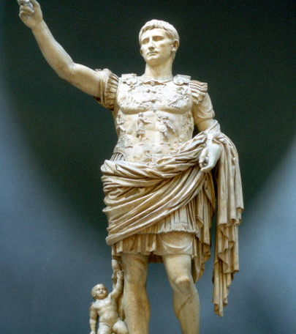
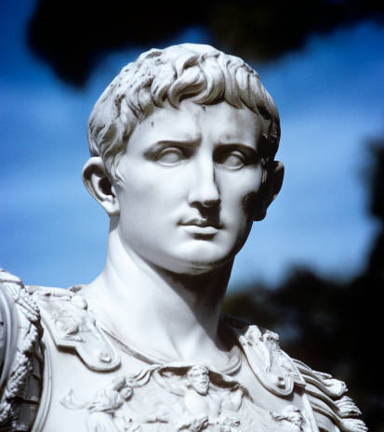
https://www.gettyimages.com.au/

Slide 4
A SINGLE BIT OF GOOD NEWS TRANSFORMS A NOBODY INTO THE RULER OF THE WORLD
In March 44 BC, an 18 year-old boy receives some unexpected good news! His great-uncle had adopted him as his son & rewritten his will so that he would inherit his uncle’s wealth.
This catapults this boy into such wealth and power that he becomes sole ruler of Rome and ultimately the first emperor of the Roman empire in 27 B.C. This boy was to take the name of
Gaius Julius Caesar Augustus
His reign led to a time of peace & stability for the Roman empire

Slide 5
‘ Providence, which orders all things and is deeply interested in our life, has set things in perfect order by giving us Augustus….and by sending him as a Saviour¹ for us and our descendants that he might end war and make all things beautiful. Since by his appearing Caesar has exceeded the hopes of all who awaited this Good News² the birthday of the god Augustus marks the start of the
Good News² about him for the world.’
¹ σωτήρ
² εὐαγγέλιον
Inscription found in the city of Priene in Asia Minor dated 9 B.C.

Slide 6
AND SO IT BEGINS…
LUKE 2: 1 - 4

Slide 7
Augustus Caesar decrees that all Roman citizens must be registered.
It occurs during the first registration during of Quirinius, governor of Syria, first term of office
Joseph and Mary travel some 100 miles (160 km) from Nazareth in Galilee to Bethlehem in Judea.

Slide 8
The BIRTH
LUKE 2: 5 - 7

Slide 9
“And while they were there,
the time came
for her to give birth”
Luke 2: 6 (ESV)
GOD WILL MOVE WHEN THE TIME COMES –
IN HIS TIME, IN HIS WAY,
HE WILL MOVE & NOTHING WILL STOP HIM

Slide 10
“…there was no place
for them in the inn
[or guest room]”
Luke 2: 7 (ESV)
ALTHOUGH MARY’S CRITICAL CONDITION
WAS OBVIOUS TO ALL,
NO ONE GAVE UP ACCOMODATION TO HER AND JOSEPH

Slide 11
“…there was no place for them in the inn
[or guest room]”
WHAT THE INHABITANTS OF BETHLEHAM DID IN THEIR IGNORANCE IS DONE BY MANY OF US TODAY –
WILL WE RECOGNISE THE MOVE OF GOD IN OUR MIDST?
WILL WE GIVE PLACE TO THE SON OF GOD?

Slide 12
WILL WE MISS COMPLETELY,
LIKE MOST OF THE PEOPLE OF BETHLEHEM,
THE COMING OF MESSIAH?

Slide 13
THIS CHRISTMAS, WILL WE GIVE
NO ROOM TO JESUS CHRIST IN OUR
FEELINGS,THOUGHTS,
AFFECTIONS, WISHES,
DECISIONS, ACTIONS
OR
OUR DAILY CONDUCT?

Slide 14
WILL WE DENY OURSELVES
THE GREATEST PRIVILEGE EVER
AND
THEREBY INCUR THE GREATEST LOSS
TO OUR LIVES?

Slide 15
THERE IS A DIFFERENCE BETWEEN
EXPECTING GOD TO ACT
AND
ANTICIPATING
HOW GOD WILL ACT

Slide 16
The first is called faith;
the second is presumption

Slide 17
Presumption is a sin
Examples:
Psalm 19:12-13; 2 Peter 2:10; 1 Samuel 15:23; James 4: 13; Numbers 14:44; Numbers 15: 30,31; 1 Corinthians 12:9; Deuteronomy 17: 13; Proverbs 3: 5,6; Deuteronomy 18:20

Slide 18
The Jews were expecting their Messiah to come,
but
their mistake was assuming what His coming
would look like.

Slide 19
They never anticipated that Messiah would be born to two relatively poor nobodies¹
&
under such miserable conditions
¹ Leviticus 12: 18 cf. Luke 2: 24

Slide 20
IS GOD TRYING TO SPEAK TO YOU THROUGH YOUR CIRCUMSTANCES?
ARE YOU MISSING WHAT HE IS SAYING AND DOING?

Slide 21
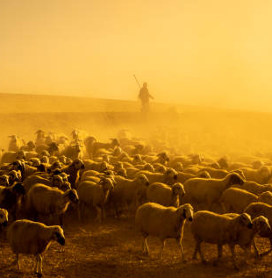
THE FIRST VISITORS TO THE KING…
LUKE 2: 8- 20

Slide 22
Nobody ever expected
that the first visitors
to the King
would be a bunch of lowly outcasts and vagabonds¹
¹ Genesis 46: 32 – 34; Micah 4: 6 – 8

Slide 23
An angel of the Lord
appeared to them,
and
the glory of the Lord
shone around them,
and
they were filled with great fear.
Luke 2: 9 (ESV)

Slide 24
www.istockphoto.com

Slide 25
The announcement
LUKE 2: 9 - 14

Slide 26
And the angel said to them,
Fear not,
for behold, I bring you good news¹ of great joy that will be for all the people. For unto you is born this day in the city of David a Saviour², who is Christ the Lord
Luke 2: 10, 11 (ESV)
¹ εὐαγγέλιον
² σωτήρ

Slide 27
Luke tells Theophilus that
Messiah has come
and although his first palace was a stable and his first visitors were shepherds,
that nevertheless
He was a better Saviour
than any Caesar.

Slide 28
And not just “Saviour”
but also “Christ the Lord” –
the Anointed One, the Messiah of God who is also God Himself.

Slide 29
“Christ” refers to Him as
Fulfiller of the promises of God
and as the One anointed by God as the great Prophet, Priest and King – the divine Saviour.

Slide 30
RESPONSE REQUIRED
LUKE 2: 15 - 20

Slide 31
“let us go...and see this thing…which the Lord has made known”
“And they went with haste and found..”
Luke 2: 15, 16 (ESV)

Slide 32
“and when they saw it, they made known the saying that had been told them..”
“and the shepherds returned, glorifying and praising God for all that they had seen and heard”
Luke 2: 17, 18, 20 (ESV)

Slide 33
“But Mary
treasured up all these things, pondering them in her heart”
Luke 2: 19 (ESV)

Slide 34
GREAT FEAR
good news
GREAT JOY

Slide 35
GLORIOUS
HOPE!!

Slide 36
Glorious hope
because the way Messiah came means that
NOTHING IS BEYOND GOD’S REACH
God uses all circumstances to fulfill His loving plan for all of us
Romans 8:28

Slide 37
Messiah came
to the humblest of towns,
disguised in poverty & homelessness, in a feedbox in one of the dirtiest places possible,
in fulfilment of promises spoken centuries ago.

Slide 38
Caesar Augustus made a decree from his throne in Rome,
but
it was the LORD enthroned on high who had chosen the perfect time to move.
It was Caesar’s proclamation
BUT
it was God’s providence at work

Slide 39
The birth of Messiah gives all of us the assurance that no matter how filthy our hearts may be,
He can, and will, dwell there
when we make room for Him.

Slide 40
When we make room for Messiah, He will take up residence and His blood will make the filthiest of sinners white as snow.
Isaiah 1:18; Romans 8:28

Slide 41
Our God is no mere man subject to fickle decisions.
He is far greater than Caesar could ever aspire to be.

Slide 42
Glory to God in the highest,
and on earth
peace
among those with whom He is pleased!
Luke 2: 14 (ESV)

Slide 43
He is now inviting everyone,
both Jew and Gentile,
to seek His favour and to discover that He offers something far greater than Pax Romana.
He has come to bring peace between heaven and earth

Slide 44
www.clichurch.com
“Behold the dwelling place of God is with man.
He will dwell with them, and they will be His people, and God Himself will be with them as their God.
He will wipe away every tear from their eyes, and death shall be no more, neither shall there be mourning, nor crying, nor pain anymore, for the former things have passed away”
Revelation 21: 3, 4
(ESV)

Slide 45
EXPECTATIONS MET UNEXPECTEDLY
LUKE 2: 1 - 20
CLIC; 23-25 INTREPID STREET, BERWICK
December 22nd 2024

